Slide 1
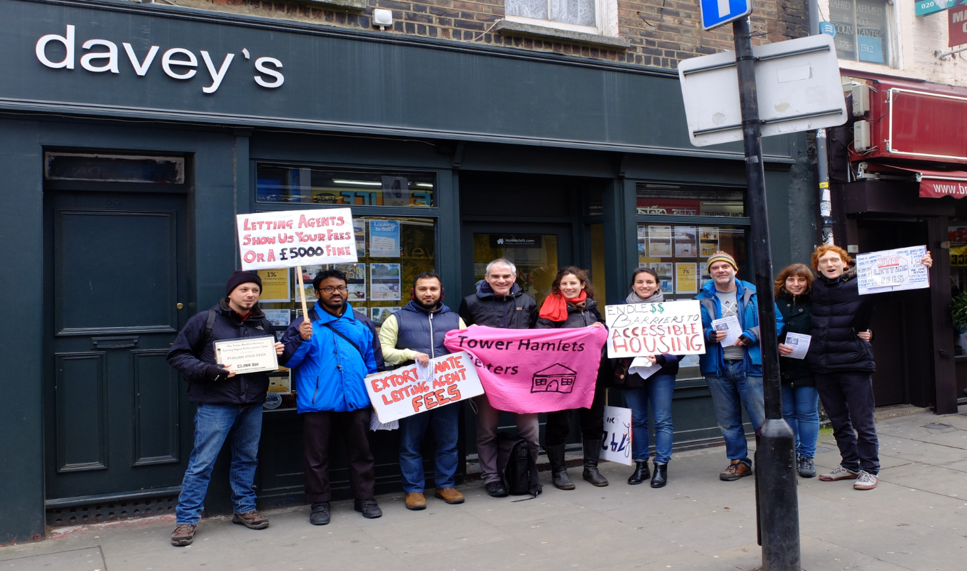
Britain’s Generation Rent

Slide 2
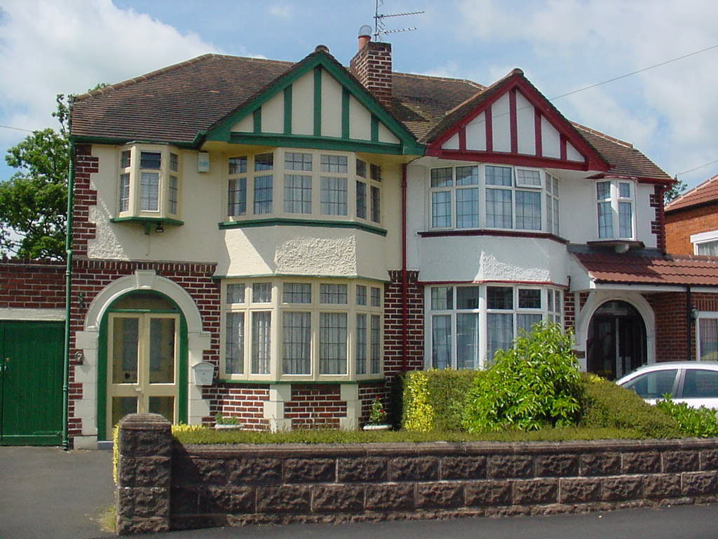
The role of home ownership
“ The British obsession with the property ladder seems as much part of our national identity as misquoting Churchill and losing football matches.” (Phineas Harper)
Over the last 30 years – observable change in the language, culture and attitudes of British people towards home-ownership (not just an aspiration but almost a right)

Slide 3
The role of home ownership
Thatcher’s idea of “property owning democracy”
ownership = key to a cohesive, safe and moral family life + sign of having a stake in society (dependence on social housing seen as discouraging personal responsibility and initiative > council housing stock sold off under Right to Buy)
Recently = importance of owning a house as a “pension pot“ > with retreating welfare state, property takes the place of social provision, especially for old age

Slide 4
Decline in home ownership
Despite the high value placed on it, home ownership is currently at its lowest point in 30 years due to an acute housing crisis
  shortage of land; low building activity
  property speculation; buy to let business
  skyrocketing house prices
  high deposit needed to buy property
Coupled with precarization of the labour market and trend toward low-wage economy > especially younger cohort are priced out of the property market with private renting as the only option

Slide 5
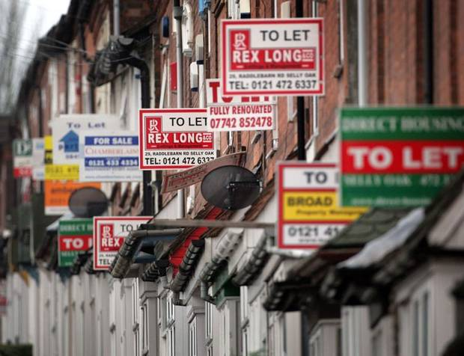
Generation Rent
New word suggestion by Collins dictionary:
“People born in the 1980s who have no hope of getting on the property ladder”
http://www.collinsdictionary.com/submission/107/generation+rent+
  overwhelmingly young people/overlap with the Millenials
  a cohort faced with the prospect of lifetime renting
  Although for a smaller segment renting is a choice, for the majority (2/3)it is an unwelcome necessity

Slide 6
Implications of renting in Britain
While a neutral and often popular choice on the Continent, renting in Britain has far-reaching impact on the individual’s life due to being
  a] overpriced
  b] insecure
  c] often unsafe and unhealthy

Slide 7
a] overpriced
Housing shortage – pushes prices up
In 2016 - average monthly rent rose to £764 outside London and £1,543 in London
According to ONS > four in five new jobs are in sectors averaging under £16,640 for a 40-hour week. Working full-time on the £6.31 hourly minimum wage would gross just £13,124 in a year (£ 1,093 a month)
Many young people – unable to obtain full-time jobs (flexible + zero-hour contract, agency work)
> renting becomes unaffordable and often impossible without sharing, hot-bedding etc.
Not to mention the unemployed ….

Slide 8
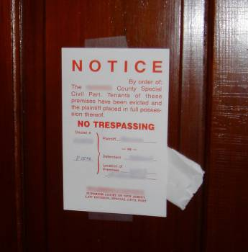
b] insecure
Britain’s private tenants in Britain - fewer rights in law compared to those on the Continent > with no real security of tenure, short tenancy agreements, and no right to stable rents.
High fluctuation of tenants; end of tenancy connected with risk of homelessness.
Revenge evictions (after tenants demand repairs or quality improvements)

Slide 9
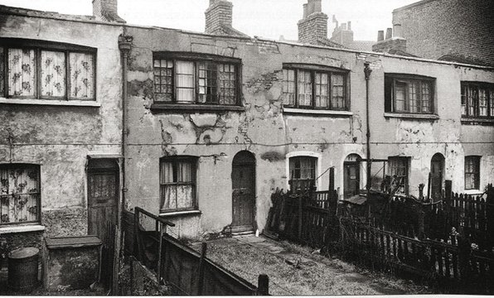

c]unsafe + unhealthy
Penny Anderson (Rentergirl): “Houses in multiple occupation often have bathrooms squeezed into former cupboards, and it shows; damp and mould thrive in confined, poorly ventilated hutches. Rubbish is usually stored outside one unlucky window, so those sultry summer nights are a constant source of joy, what with the maggots,
stench, and cats.”
Orwell: “Then there is the misery of leaking roofs and oozing walls, which in winter makes some rooms almost uninhabitable. Then there are bugs. Once bugs get into a house they are in it till the crack of doom. Then there are windows that will not open.”

Slide 10
Impact on social and cultural capital
The loss GR face is not merely material
Authors the Jilted Generation”; here is why:
  Postponement of adulthood – main attributes denied to them (family, savings, realizing ambitions and ideas, stability, having children)
  Loss of opportunity to establish meaningful communities – nomadic life
  The constant financial pressure prevents them from engaging in social life, culture, travelling (outside social media) > the breadth of life is narrowed down, with the ability to pay the rent being the focal point; existence rather than true life

Slide 11
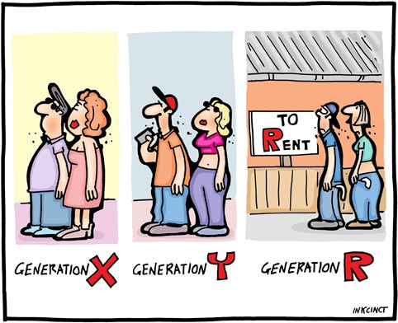
“We work in jobs and live in homes secured on short-term contracts; the steps of our lives are constantly meandering. We’re not settled. Indeed, for many of us, only our childhood homes represent a fixed point, a permanent address, and so we return to them constantly and sometimes permanently. And all this holds back the start of our own lives, the forming of stable relationships and the mastering of our own destinies”.
Facing lack of understanding:
  criticism: KIPPERS (Kids in Parents’ Pockets Eroding Retirement Savings’), Boomerang Kids, freeloaders, etc.
  pity (iPods – Insecure, Pressurized, Overtaxed and Debt-Ridden)

Slide 12
Finding agency
Previously, the term Generation Rent was imposed by people outside the group to describe its predicament
Recently – it has been adopted by members of GR themselves > a social identity based on the shared experience of life as renters
Original sense of victimhood replaced with collective action

Slide 15
Gaining agency – organizing themselves

Slide 16
Gaining agency - campaiging

