Slide 1

Brief History of Modern Neural Networks
Ing. Marek Hrúz PhD.

Slide 2


Image Classification
CAT
DOG
Taks of assigning a class label to an image.
Historically, people described the images by handcrafted features and trained a classifier.
Works reasonably well for small, non-complex, well-defined data.
To allow a next big leap in computer vision a new dataset was developed.
ImageNet - an image dataset organized according to the WordNet hierarchy.
  Total number of non-empty synsets: 21,841
  Total number of images: 14,197,122
  Number of images with bounding box annotations: 1,034,908
SIFT + FVs in 2011 achieved Top-1 accuracy of 50.9% (1000 classes).

Slide 3
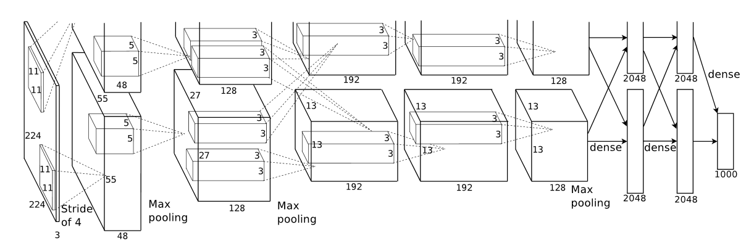
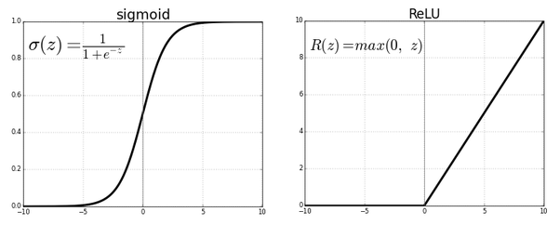
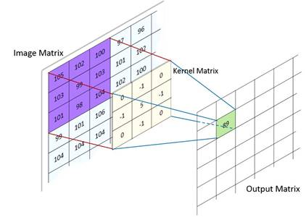
AlexNet 2012
Introduces Convolutional Neural Networks to the task of ImageNet classification.
The CNN is distributed on 2 GPUs.
Main features:
  Novel, deep CNN architecture
  ReLU non-linearity
  Overlapping max-pooling
  Data augmentation for overfitting reduction
  Dropout
Achieves Top-1 accuracy of 63.3%

Slide 4
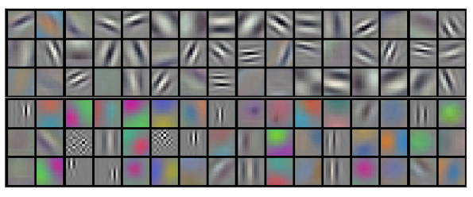
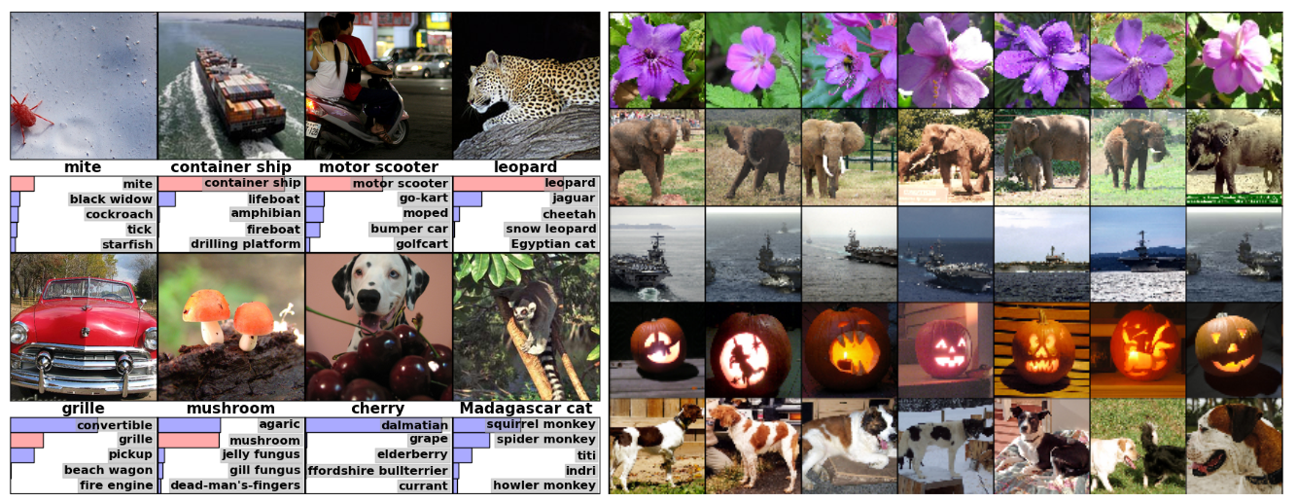
CNN implications
Convolutional filters can be visualized and explained.
The shift from algorithm design to data preparation.
Semantic representation in deep layers.

Slide 5
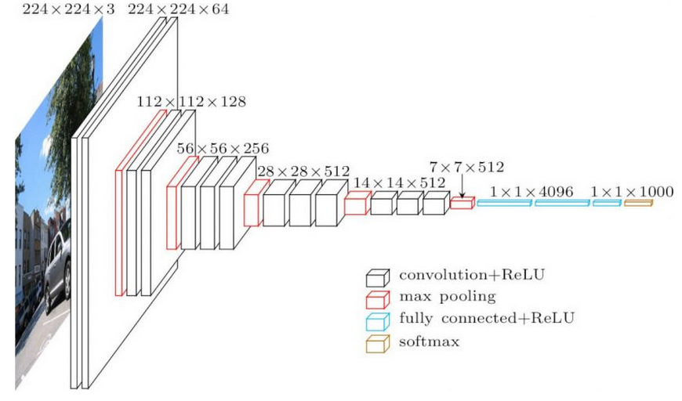
VGG 2014
From Google.
Scheme for deeper models.
Small sizes of convolution
kernels (3x3 instead of 11x11).
Back to non-overlapping pooling.
Achieves Top-1 accuracy of 74.4%

Slide 6
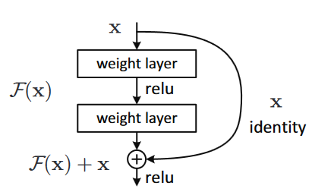
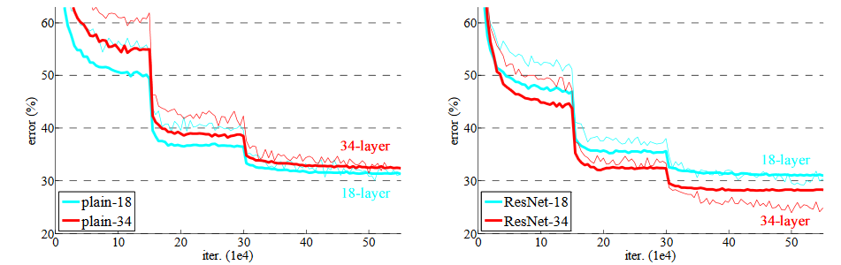
ResNet 2015
Addresses the problem of vanishing and exploding gradients.
Introduces residual (skip) connections.
They allow a better flow of the gradient.
Achieves Top-1 accuracy of 78.6%

Slide 7
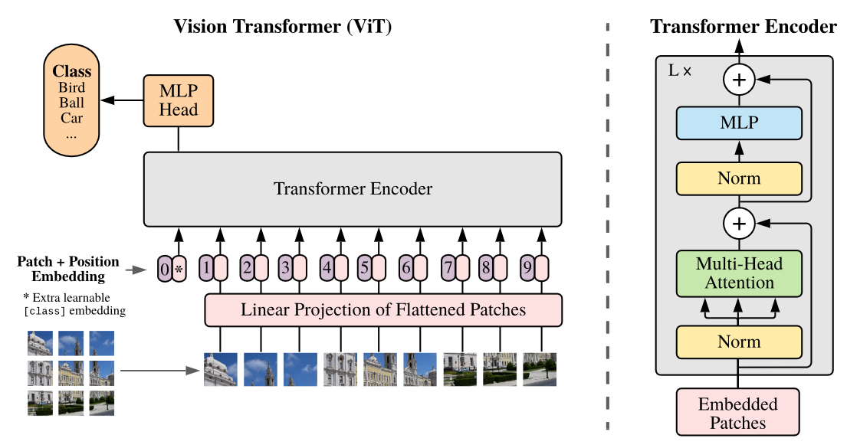
Image Classification in 2020
In 4 years, the Top-1 acc increased from 50.9% to 78.6%
View results on paperswithcode.com
Best result in 2020 produced by a CNN is 88.5% accuracy
Transformers are overtaking?
Top-1 acc 88.55%
Language Models improve results
Tensorflow playground
Keras
PyTorch

Slide 8
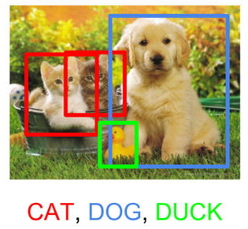
Object Detection
Task of recognizing and localizing an object.
Historically, two stages:
  Region proposal
  Region classification
MS COCO
  Object segmentation
  Recognition in context
  Superpixel stuff segmentation
  330K images (>200K labeled)
  1.5 million object instances
  80 object categories
  91 stuff categories
  5 captions per image
  250,000 people with keypoints
Pascal VOC
  9,993 annotated images

Slide 9
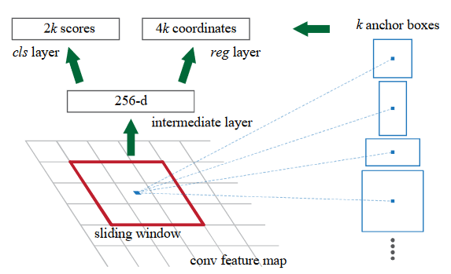
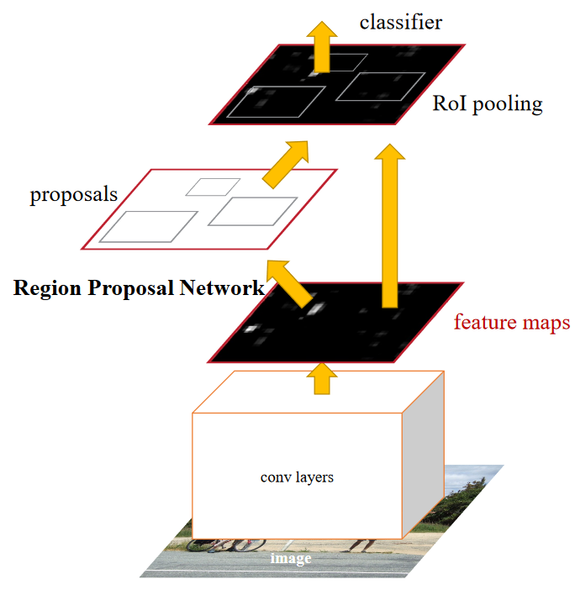
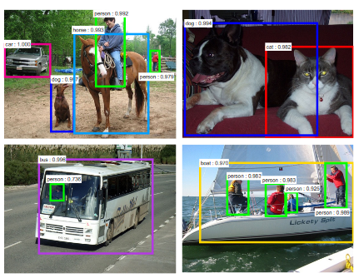
Faster R-CNN 2015
mAP@0.5 = 42.7% for COCO

Slide 10
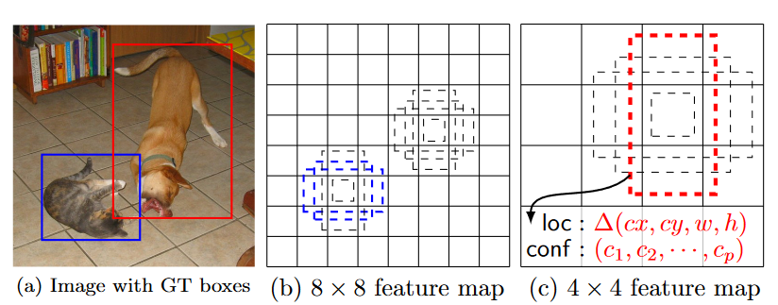
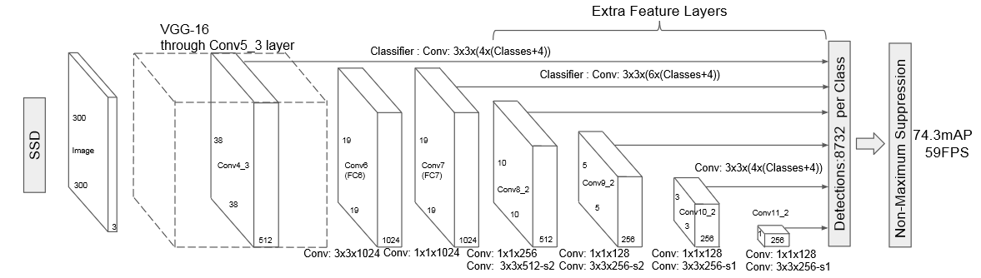
SSD early 2016
mAP@0.5 = 46.5% for COCO

Slide 11
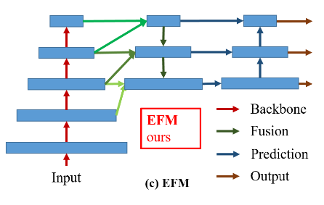
Object Detection and Tracking
In 2024 the best performing detector on COCO has 66% mAP (from 2022).
Example video of tracking by detection

Slide 12
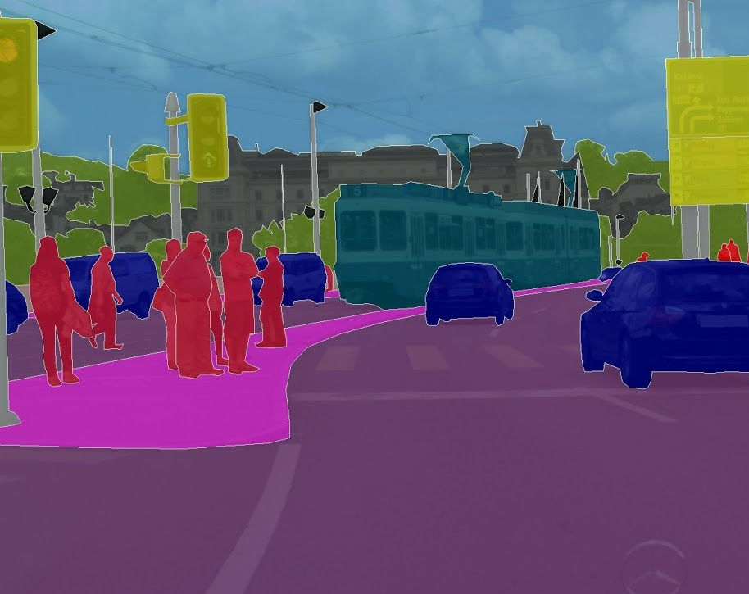
Semantic Segmentation
CityScapes
Pascal VOC, MS COCO
Task of assigning each pixel a class label

Slide 13
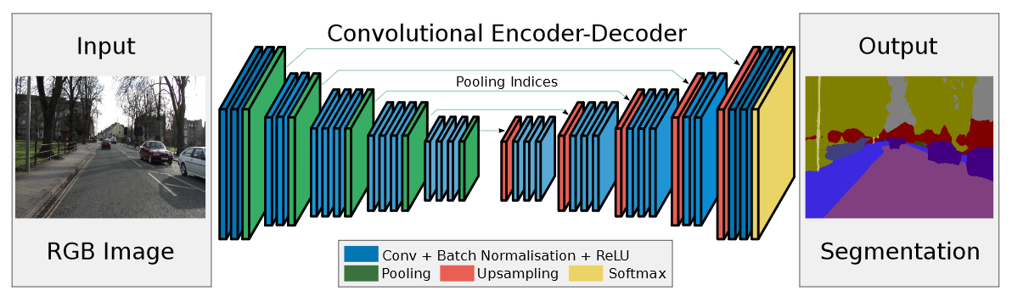
SegNet late 2015

Slide 14
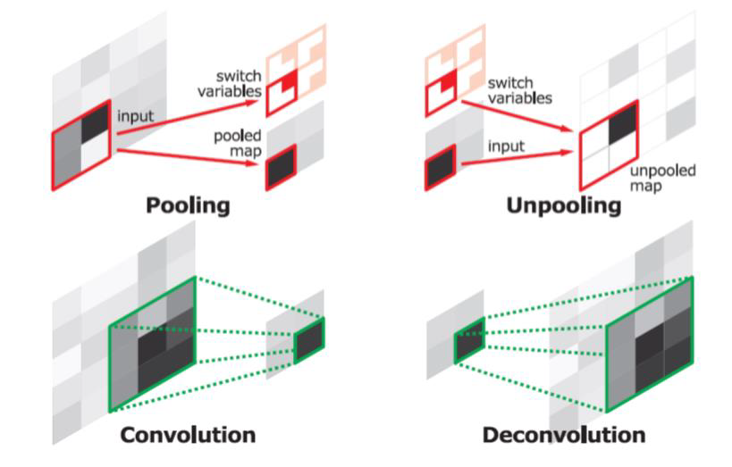
How to upsamle?

Slide 15
SegNet late 2015
Online DEMO
Mean IoU 57.0% CityScapes

Slide 16
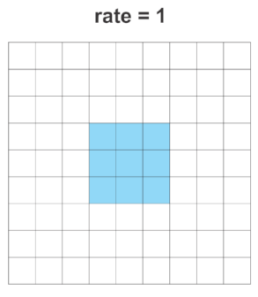
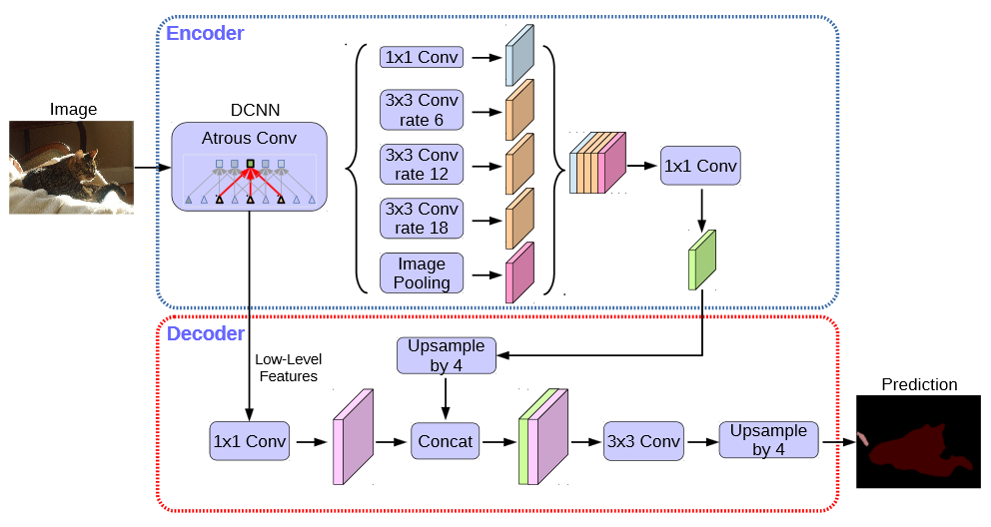
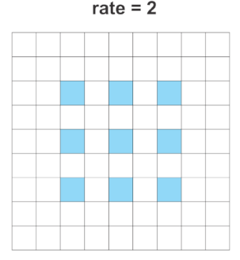
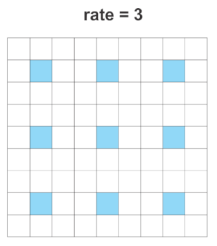
DeepLab 2014 - 2018
Mean IoU 82.1% CityScapes​
DEMO

Slide 17
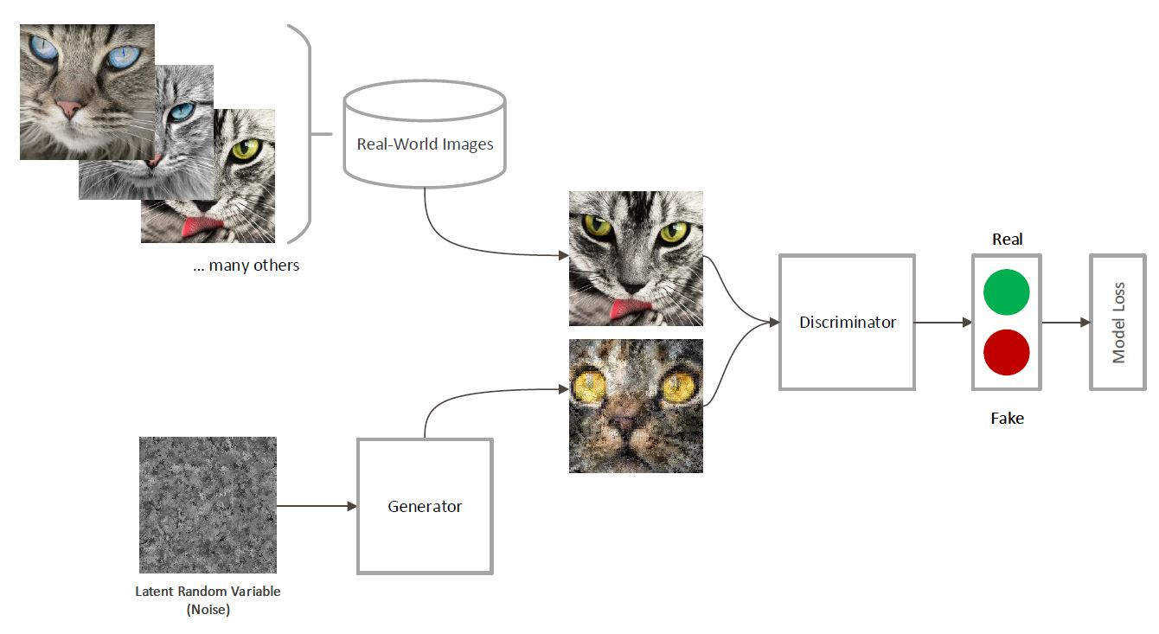
Generative Adversarial Networks 2014
Models for generating data from noise or other provided input
https://www.nvidia.com/en-us/studio/canvas/
https://www.whichfaceisreal.com/

Slide 18
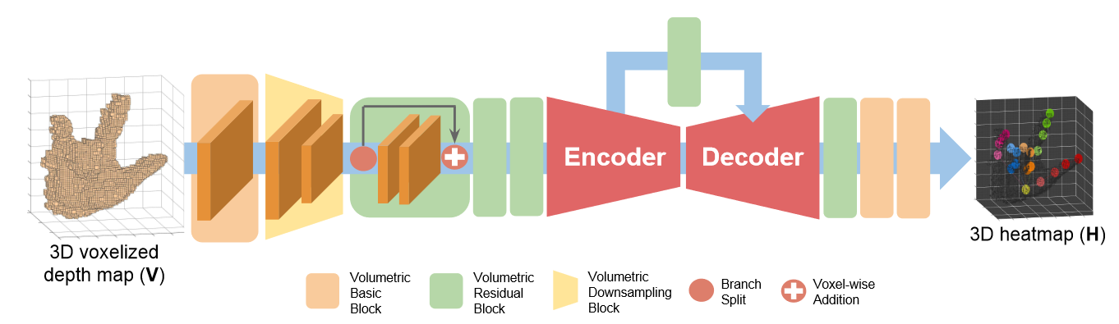
Regression
Instead of assigning a class to data, we want to approximate a function
Given values of x and f(x), we train a model of NN
Hand Pose Estimation

Slide 19


Use Papers With Code

